Slide 1
CAR Administration Overview
Module 1 – Introduction and Nonconformances

Slide 2
Introduction to Modules
Course Structure:
  Nonconformances
  Responsibilities and CAR Ownership
  Root Cause Analysis
  Corrective Action Plans
  Accepting Implementation
  Verifying Effectiveness
  Supplement – Tips and Tricks (optional)
  Supplemental Exercise Module

Slide 3
Objectives for this course
Overview of UL’s requirements for CARs
Provide a better understanding of the expectations of an acceptable root cause analysis and corrective action plans
Provide examples of ‘good practices’
Applying concepts to practice with exercises and discussions

Slide 4
Evolution from Conformance to Performance
high
Certification /
Accreditation
Benchmarking
Best Practices
Synergetic
Excellence
Performance
Excellence
Partnership
Meeting
Accreditation
Requirements
Performance
Excellence
Criteria
Organizational Performance
External
Improvement
Models
Self-directed
Improvement
Organizational Results
Regulatory
low
Conformance
Driven
Performance System Maturity
or Transition Continuum
Performance
Driven
Notes:
Regulatory = compliance check-list mentality, “good enough is good enough”.
Self-directed Improvement = “what can we do that’s better?” approach.
External improvement models = systematic approaches (e.g., TQM, JIT, CQI, TCS).
Performance Excellence Criteria = Holistic approach to systemic performance improvement (e.g., AQIP, Baldrige). Somewhat inward looking.
Performance Excellence Partnership = establishing synergy between education and business to accomplish a common mission (e.g., Valley View Partnership). Adding value to all Partners.

Slide 5
CARs – Present and Future
Corrective Action – “An action that corrects a variance or non-conformity and prevents recurrence”
Preventive Actions – “An action taken to eliminate the causes of a nonconformity, defect or other undesirable situation, to prevent occurrence”
Continuous Improvement – “The constant effort to eliminate waste, reduce response time, simplify the design of both products and processes, and improve quality and customer service”

Slide 6
Disclaimer
This presentation contains actual examples from the CAR Tool. All information contained within this presentation is UL Company Confidential.
This presentation is not intended as personal critiques of CAR Administrators or CAR Owners but is intended as a learning tool to help improve UL’s CAR Process. Where possible, names and identifiers have been removed from the CAR examples.
Some examples are taken out of context to highlight various concepts for training purposes.

Slide 7
Why do we need a formal corrective action system?
It is one of the fundamental elements of a Quality system
Our quality standards (ISO/IEC 17025, ISO/IEC Guide 65, etc.) require it; therefore, our accreditors confirm that we have a system and that it is effective
It is a tracking system to make sure actions take place
It provides accountability
It allows us to evaluate problems and determine opportunities for further continuous improvement

Slide 8
What exactly is a corrective action?
A series of steps to address an identified existing nonconformance such that the nonconformance is eliminated and prevented from recurring
  Identifies the root cause of the problem
  Determines appropriate and reasonable action plan
  Implements the action plan
  Verifies the effectiveness of the action taken

Slide 9

We want the corrective action system to be like The Orkin Man…
“Kills the bugs you have now and keeps them from coming back”

Slide 10
Nonconformances

Slide 11
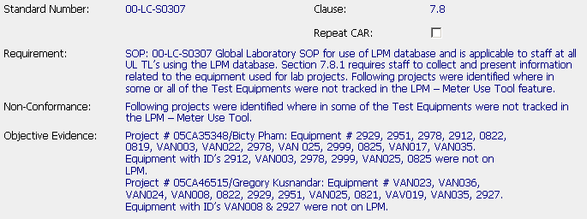
Nonconformances

Slide 12
Nonconformances
Reference to standard, policy, process, etc.

Slide 13
Nonconformances
Summary of the requirement that is relevant to the nonconformance

Slide 14
Nonconformances
Concise clearly stated nonconformance

Slide 15
Nonconformances
Objective evidence provides enough details to verify

Slide 16
Nonconformances
Linkage – The Standard relates to the Requirement which links to the Nonconformance which links to the Objective Evidence

Slide 17
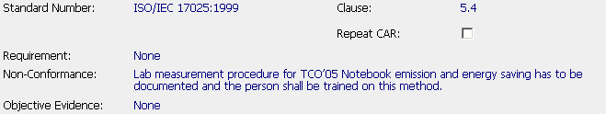
Review this nonconformance

Slide 18
Review this nonconformance
Stating ‘None’ as a requirement is not acceptable
The nonconformance reads more like a requirement
Need to have Objective Evidence

Slide 19
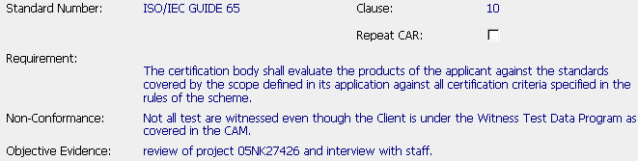
Nonconformance – Linkage to Requirements?

Slide 20
Nonconformance – Linkage to Requirements?
Requirement is Guide 65. . .
. . . but nonconformance is against the CAM.

Slide 21
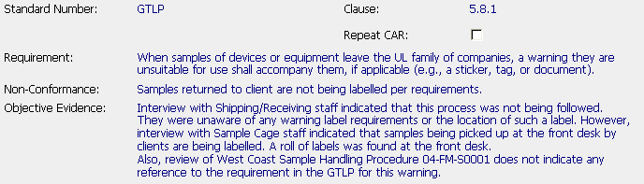
Group Discussion - Nonconformance

Slide 22
Group Discussion - Nonconformance
Mandatory, but. . .
. . . when is this requirement applicable?
What is the nonconformance?
Term “e.g.” shows examples, but after the phrase ‘if applicable’. What is the requirement?

Slide 23
CARs – Finding or Observation?
Finding
“A nonconformance to a requirement or procedure in which the violation can be clearly supported with objective evidence against an applicable document or procedure. The problem is systemic and/or recurring and/or severe.”
  Requires a full root cause analysis, corrective action plan, and verification of effectiveness.
  Can be changed to an Observation only with approval of the Originator
Observation
“A nonconformance that does not appear to be systemic. “
  Suggestion for Improvement
    This is a suggestion
    Owner decides whether to address the suggestion
    If they agree, then root cause and plan are required
  Document a record
    Written if another CAR is addressing long-term actions so only the record in the nonconformance need to be corrected
    No root cause analysis is required, only a plan to correct the records.
The CAR Originator determines whether CAR is Observation or Finding. The CAR Administrator can consult with Originator if there is a question.

Slide 24
Nonconformance Summary
References the applicable requirement
Clear, concise, and accurate
Includes the objective evidence in sufficient detail to allow the CAR Owner to retrieve the information
Linkage between requirement, problem statement, and objective evidence

Slide 25
End of Module 1
Revision 1.0 – Version presented to EULA team June 2007, complies with 00-QA-S0010 Issue 6.0 and 00-QA-J0029 Issue 1.0.

